Slide 1
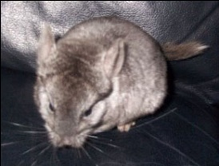
Network Access Control
MSIT 458 – The Chinchillas

Slide 2
The Problem
Viruses, worms, and botnets are often spread by unknowing victims. These victims may be your own network users.
How can the network be protected from your own users?

Slide 3
The Problem
Hey Trudy! I disabled McAfee just like you told me to!!
We still on for our date tonight?
Does Bob work for
your company?
How would you handle
this situation?

Slide 4
The Problem
Thanks for the open access to your network!
I swear I won’t touch anything!
How do you handle
guests on your network?
How much access, if any, is appropriate?

Slide 5
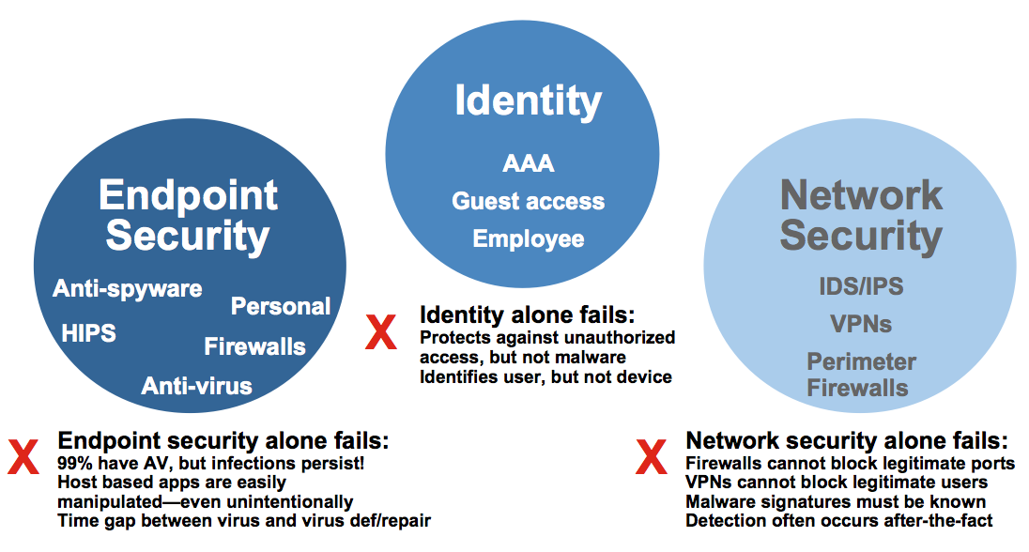
The Problem

Slide 6
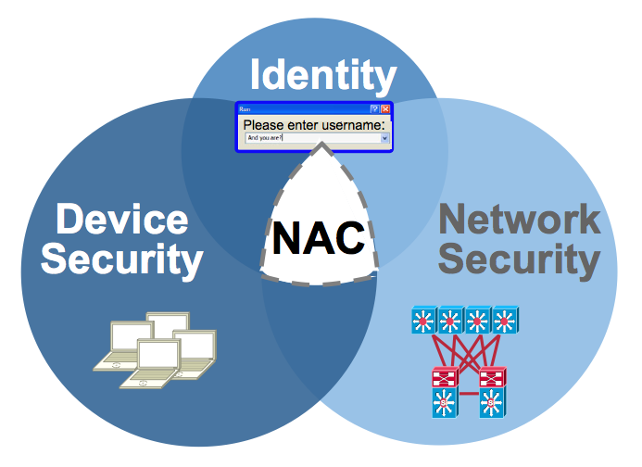
The Solution

