Slide 1
Web Based Attacks
Symantec
Defense
Fantastic Four
Casey Ford
Mike Lombardo
Ragnar Olson
Maninder Singh

Slide 2
Agenda
Introduction: Anatomy of Web Attacks
How do websites get infected?
Getting onto a user’s computer
(automatically)
Getting onto a user’s computer
(with a little help from the user)
What happens on the computer?
What you can do to protect yourself
Conclusion
Questions

Slide 3
Anatomy of Web Attacks
(How websites get attacked)

Slide 4
Anatomy of Web Attacks
Attacker breaks into a legitimate website and posts malware
  Malware is no longer exclusive to malicious Web sites.
  Today it is common place for legitimate mainstream Web sites to act as parasitic hosts that serve up malware to their unsuspecting visitors.
Attacking end-user machines.
  Malware on a Web site makes its way down on to a user’s machine when that user visits the host Web site.
  “Drive-by-download” – happens automatically with no user interaction required
  Additional techniques which do require some input from the user, but in practice are equally, if not more so, effective.
Leveraging end user machines for malicious activity.
  The most malicious activities begin once new malware has established a presence on a user’s machine.

Slide 5
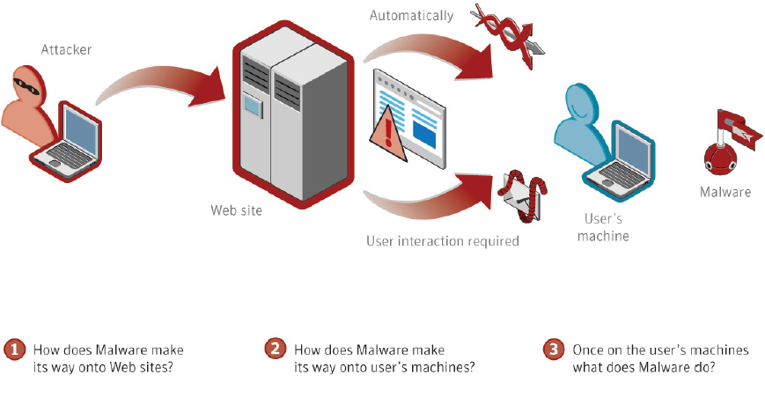
Anatomy of Web Attacks
Source: Web Based Attacks, Symantec 2009

Slide 6
How Do Websites Get Infected?
It used to be malware was only on illicit sites such as adult material and pirated software
  Targeted users looking with short-term needs
Today legitimate and mainstream websites are targets
  Complexity of websites - combination of many different Web content sources, dynamically constructed using many different scripting technologies, plug-in components, and databases
Web advertisements
  Usually third party
  A webpage can have content coming from 10-20 different domains

Slide 7
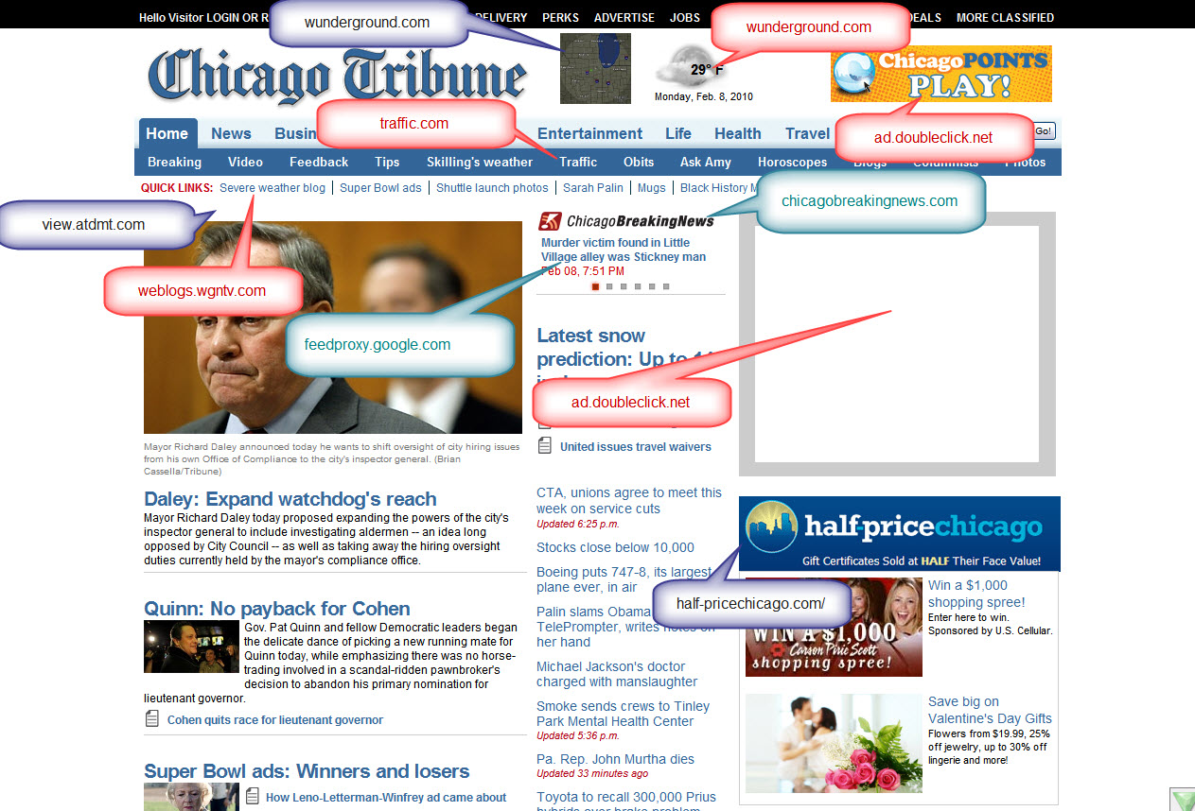
Chicago Tribune Home Page

Slide 8
How are legitimate Web sites compromised?
SQL Injection Attacks
  Finding flaws in Web sites that have databases running behind them.
  A poorly validated input field in a Web input form may allow an attacker to insert additional SQL instructions which may then be passed directly into the backend database
  Trojan.Asprox and IFRAME Tag
Malicious Advertisements
  Many Web sites today display advertisements hosted by third-party advertising sites
  Volume of ads published automatically makes detection difficult
  Random appearances further compounds the detection
Search Engine Result Redirection
Attacks on the backend virtual hosting companies
Vulnerabilities in the Web server or forum hosting software
Cross-site scripting (XSS) attacks

Slide 9
GETTING ONTO A USER’S COMPUTER
(AUTOMATICALLY)

Slide 10
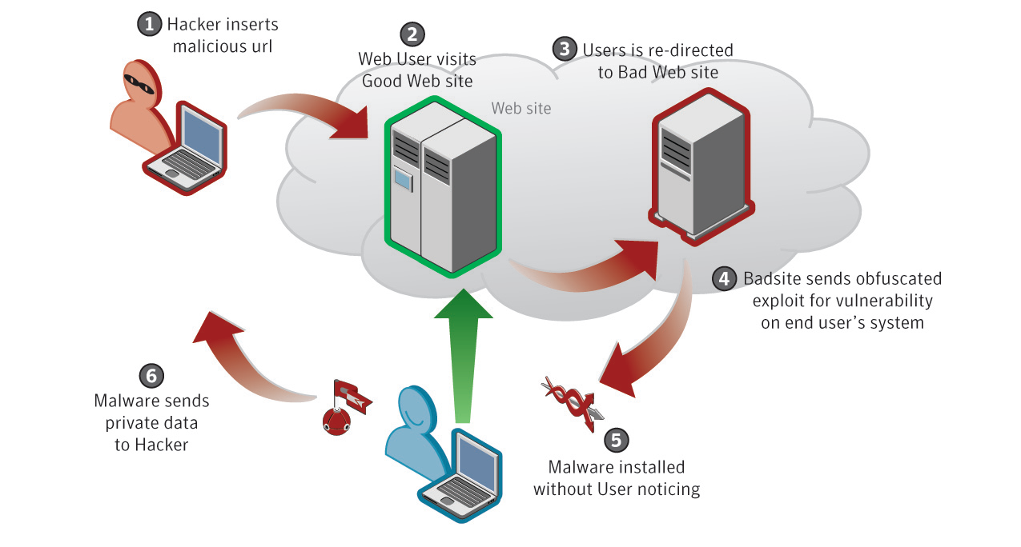
GETTING ONTO A USER’S COMPUTER
Source: Web Based Attacks, Symantec 2009

Slide 11
Automatic Attack Exposure
Techniques used to deliver malware from Websites to a users computer.
Exposure
  Browsing a website
  No user interaction is required
  Executable content is automatically downloaded

Slide 12
Typical Sequence of Events
Attacker compromises a good website
Visit website
Redirected to a bad website
Corrupt code is downloaded
Installed on the computer
Corrupt software takes control

Slide 13
Attack Toolkits
Profiling the victim
      Based on the Specific Operating System
      Browser Type
Timing the attack
      Attack only once every hour
Geographical variances
      Regional attacks on users
Selective use of vulnerabilities
      Based on the protection of the users
Random attacks
      No pattern, no reason, unpredictable

Slide 14
“Click Jacking”
The click of link executes the attacker’s code
Often leading the person to a malicious website.

Slide 15
Frequency of Attacks
Thousands of times every day
In 2008
  18 million infection attempts
  Continues to increase

Slide 16
GETTING ONTO A USER’S COMPUTER
(WITH A LITTLE HELP FROM THE USER)

Slide 17
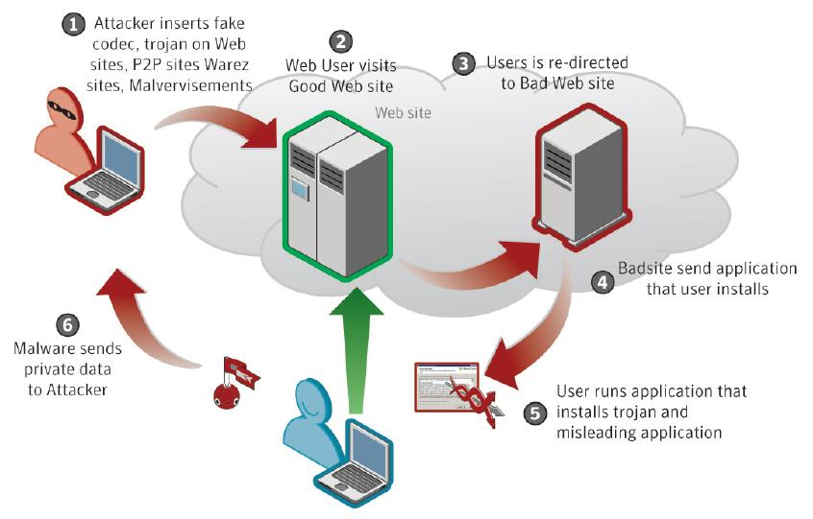
Social Engineering
People are tricked into performing actions they would not otherwise want to perform
Source: Web Based Attacks, Symantec 2009

Slide 18
Types of Social Engineering Attacks
Fake Codec
Malicious Peer-to-Peer (P2P) Files
Malicious Advertisements
Fake Scanner Web Page
Blog Spam
Other Attack Vectors

Slide 19

Fake Codec
User is prompted to install a missing codec
Codec is actually malware code
  Usually a trojan horse

Slide 20
Malicious Peer-to-Peer (P2P) Files
Malware authors bind content into popular applications
  Files named after celebrities, popular bands
  Uploaded to popular P2P sites where they are downloaded by unsuspecting users
Openly available how-to materials on the internet
  Details how to build and distribute malware
  Pay-Per-Install malware (Guide)

Slide 21
Malicious Advertisements
Malware authors advertise their fake codecs to unsuspecting users
  Use legitimate advertising channels
  Sponsored links pointed to pages masked as legitimate downloads for official versions of software
Advertising providers have taken notice, but this is difficult to mitigate owing to volume

Slide 22
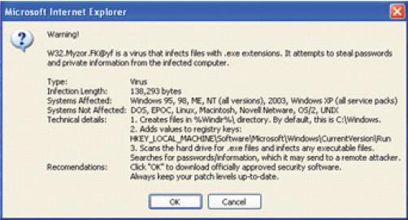
Fake Scanner Web Page
Create a web site or product that misrepresents the truth
  JavaScript pop-ups notifying of false need to install operating system updates
  Tools that claim to scan for and remove adult images, etc.
Source: Web Based Attacks, Symantec 2009

Slide 23
Blog Spam
Alluring links posted on blogs
  Links embedded in blog comments
  Direct users to sites that leverage social engineering tricks or browser exploits to spread malware

Slide 24
Other Attack Vectors
Spam
  Emails contain links directing people to drive by download, fake scanner/codec, and malware sites
Pirated software sites
  Pirated versions of software are bundled with or comprised solely of trojan horses

Slide 25
WHAT HAPPENS TO YOUR COMPUTER?

Slide 26
What happens to your computer?
Leading Malware: Misleading Applications
  Also referred to as rogueware, scareware
Intentionally misrepresent security issues
Social engineering to entice product purchase
Malware activities:
  Prevent users from navigating to legitimate antivirus vendors
  Prevents itself from being uninstalled
  Pops up warnings that the system is infected and that the software needs to be purchased in order to clean system

Slide 27
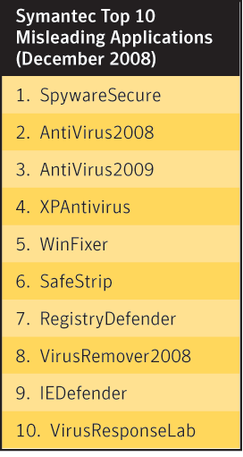
Top 10 Misleading Software
Thousands of individuals defrauded
23 M attempts in last 6 months of 2008
1% => $11M revenue
Polymorphing tools
  Repackages itself
  Hard to detect
Source: Web Based Attacks, Symantec 2009

Slide 28
Misleading Software Example
Source: Web Based Attacks, Symantec 2009

Slide 29
Other Malware Activities
Stealing personal information
  Keyloggers
    capture username, passwords for various sites
      Banking, Shopping, Gaming and email accounts
    Capture credit card numbers
Botnet proliferation
  Remote control to coordinate large scale attacks

Slide 30
WHAT CAN YOU DO TO PROTECT YOURSELF?

Slide 31
Software Protection
Update and Patch Software
  Get latest OS, Browser, Application patches
  Browswer Plug-in updates often forgotten
Endpoint Protection Software
  Heuristic File Protection
  Intrusion prevention system – prevent drive by
  Behavioral monitoring
Update Protection Software Subscription
  70000 virus variants possible in a week

Slide 32
Behavioral Protection
Be Suspicious
  Avoid things that seem too good to be true
  Use safe search functionality in browsers
Adopt Strong Password Policy
  Use mixture of letters, number, and symbols
  Change passwords frequently
  Use unique passwords for different sites
Prevention is the key
  Reduce or Eliminate the Vulnerability
  Adaptive experienced based techniques
  Be proactive in protecting systems
  Cheaper to prevent than the repair infected systems

Slide 33
FINAL THOUGHTS

Slide 34
Conclusion
IT Managers and end users must be Vigilant
Signature based protection software alone are not enough to protect systems
Protection strategy must be evolving to react to new threats and vulnerabilities

Slide 35
Questions?

