Slide 1
Effectively Managing System Configuration
Fantastic Four
Casey Ford
Mike Lombardo
Ragnar Olson
Maninder Singh

Slide 2
Agenda
Introduction
Infrastructure Overview
Logistics
Analysis
Problems/Solutions
Motivation

Slide 3
What is wrong?
Monthly Windows Operating System workstation patching policies are not clearly defined
Significant numbers of machines have not been patched over a month after patches have been released
Notes:
No set metrics for successful/unsuccessful distribution of monthly Windows Operating System workstation patches
No knowledge of how long it takes for patches to reach all endpoints.
No benchmark for patch saturation levels due to machine turnover (90%? 95%? 100%?
What should the target be
No knowledge of how users utilize their machines
Reboot frequency?
Laptops leaving the office?
Home Networks?
Public WiFi?

Slide 4
Why are these items problematic?
Once Microsoft addresses specific vulnerabilities with monthly operating system updates, hackers can immediately begin work to exploit those vulnerabilities with malicious code.
Slow or ineffective patch distribution leaves endpoints vulnerable to attack

Slide 5
Infrastructure Overview

Slide 6
Workstation statistics
K&E has around 1,800 laptop computers that have potential to leave the confines of the corporate network and risk infection
K&E has around 1,600 desktop computers that are also at risk even though they are less mobile

Slide 7
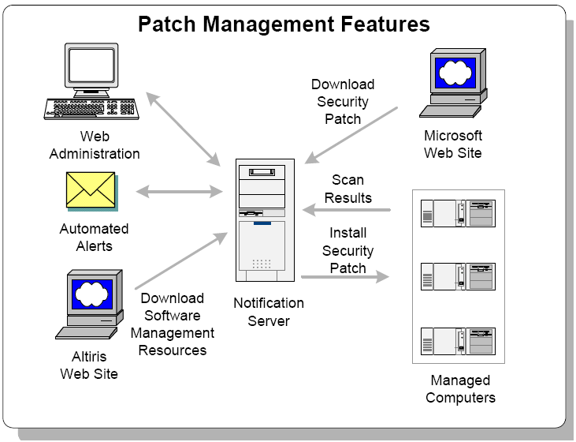
Deployment Mechanism - Altiris
Source: Altiris Patch Management 6.0 Solution Guide , https://kb.altiris.com/display/1n/kb/article.asp?aid=18720&n=60&s=
Notes:
-Agent based
-Each workstation has a software agent installed on it
-Agents report into the Notification Server every two hours
-If the agent has work to do (job execution, patch execution), it will perform it after check in
-Microsoft patches are automatically downloaded to the Notification Server on patch Tuesday
-Patches must be staged for deployment
-After patches have been staged, they must be assigned to the desired endpoints
-Patches will be executed as scheduled by the staging policy
-Required reboots are not enforced

Slide 8
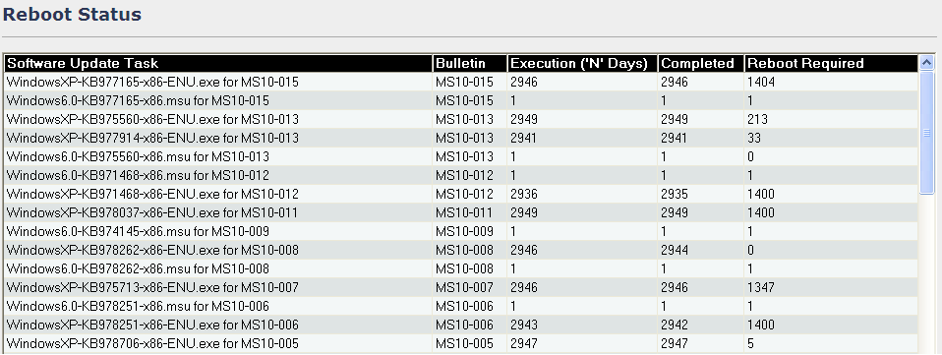
Altiris Reporting
Notes:
-Altiris reports on several aspects of patch distributions
-These are snapshots of two of those reports
-Reboot Status report shows machines that have received patches but have not updated.
-We will call these machines “Reboot Pending” machines
-Compliance and Vulnerability repot shows the compliance statistics for individual patches by applicable machines, installed machines, and vulnerabilities

Slide 9
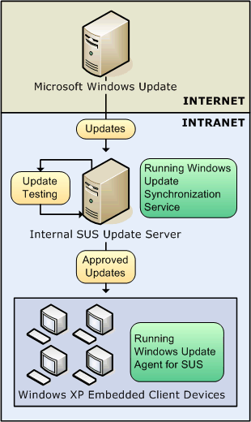
Alternative Deployment Mechanism - SUS
Notes:
Windows Software Update Services
WSUS Server is configured through the SUS management console
Synchronization with Windows Update is run on a scheduled basis
Updates are approved by the Administrator. SUS can be configured for automatic approval of critical security updates.
Client machines communicate with the internal SUS server and download/install approved updates
Shavlik is another alternative, not limited to Microsoft products. Protects legacy Microsoft products, Adobe products, Firefox, Thunderbird, Java, VMWare, Apple products, and the list goes on.

Slide 10
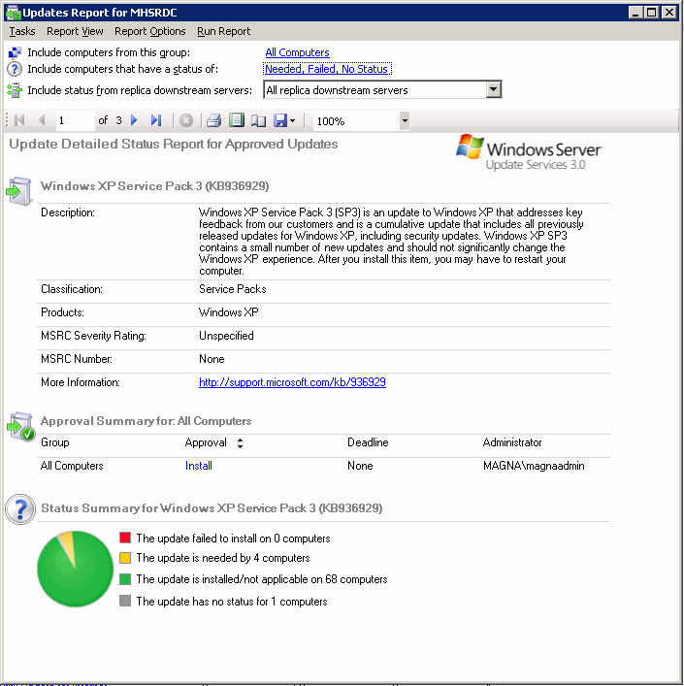
SUS Reporting
Notes:
This is a sample report run on the deployment status of Windows XP SP3. The reporting functionality can report on individual updates or individual clients. The pie chart shows how many computers have installed the update and how many still need the update.

Slide 11
Altiris/SUS Pros and Cons
 | Pros | Cons
Altiris | In-place solution In-house expertise Open DB access with SQL Adequate feedback Holistic Solution No cost for adoption | Delayed reporting Potential ambiguity with results Limited remediation tools
MS Server Update Service | Free with server license "Supported OS: Win2k, 2k pro,XP pro, Win 2003, XP-64 Bit" Supported Apps: MS Office'03, Exchange '03, Exchange '00 Downloading automatic or manual, with frequency, and product content specs Patch type: Security, non-security updates, service packs, feature packs, driver updates, tools, guidance, dev kits, connectors Robust reporting | Requires 8GB free space IE 6.0 required for running admin console, Poor logging Agent based, cannot push patch instantly, must wait for check in Does not support NT 4.0 SP4 and older, Office 2k, SQL Server, MSDE, Commerce Server 2k/2003, ISA Server, Biztalk, CMSHIS, IE, IIS, MDAC, XML, Java VM No exporting to different formats of reporting Complicated Patch Process, No reboot
Notes:
Altiris Pros:
-Altiris is the in-place solution. Is cheaper.
-In-house expertise
-Open access to SQL reporting DB for custom reports
-Provides adequate feedback
-Agent interaction with hosts
-Holistic solution
Altiris Cons:
-Delayed reporting
-Reports can be ambiguous
-Remediation tools leave a lot to be desires
Microsoft Windows Server Update Services
Pros
Price – Free
Supported Operating Systems
Service Pack 3 and later versions of Windows 2000 Server (all editions) and Windows
2000 Professional (Must have IE6)
Windows XP Professional and later versions
Windows Server 2003 family and Datacenter Edition
Windows XP family and XP 64-Bit Edition Version 2003
Supported Servers and Applications
All editions of Microsoft Office 2003 and Microsoft Office XP Service Pack 2 and above
Microsoft Exchange 2003
Microsoft Exchange 2000
Downloading Updates from Microsoft
Allows for either automatic or manual downloads of new updates from Microsoft
Can specify frequency (daily or weekly) for checking for and downloading new updates
Can specify the products and content types for which new updates should be downloaded
Current Patch Type Support
Security updates
Non-security updates (critical and non-critical) and update rollups
Service packs
Feature packs
Critical driver updates
Tools
Guidance
Development Kits
Drivers
Connectors
Reporting
You can generate reports on status of updates, synchronization results, and settings summary.
Within the groups you can specify the Computer Group you want the report on.
Cons:
Setup / Configuration
WSUS requires at least 8 GB free hard drive space to install. Recommendation is 30 gigs for storing patches.
WSUS requires Internet Explorer 6.0 or later to run the Admin console on target machines.
It’s not easy for new users to troubleshoot issues - poor logging.
WSUS is agent based, and must trace and maintain which agents are installed. There is currently no ability to push a given patch instantly. You must wait for all the agents to check in, which could be days depending on environment.
Patch Support
Does not support NT 4.0 SP4 and older, Office 2000, SQL Server, SQL Server Desktop
Engine (MSDE), Commerce Server 2000 & 2003, ISA Server, BizTalk Server, Content
Management Server, Host Integrations Server, Internet Explorer (IE), Internet Information Services (IIS), Microsoft Data Access Components (MDAC), Microsoft XML Services, Microsoft Java Virtual Machine.
Reporting
Currently, WSUS offers no exportation of reports to different file formats.
Reports are print only from the screen – no graphics!
Patch Process
WSUS needs to have:
The Patch downloaded to the WSUSAdmin Console
Then the patch then needs to be approved for target machines to scan for it
Then the target machine needs to scan and request the patch
The patch needs to be approved to be downloaded by the target machine.
Other
No Reboot function.

Slide 12
Logistics

Slide 13
Glossary
Compliant – Machine has received monthly update(s)
Vulnerable – Machine has not received monthly update(s)
Bulletin – A collection of related OS updates that have been bundled together by Microsoft

Slide 14
Schedule
Vulnerability analyses are conducted on each workstation every four hours
Results are reported into the Altiris server
Patches are immediately delivered to machines with vulnerabilities
Delivered patches are executed at 4PM local time each day
Execution schedule is flexible
To avoid user interruption, we do not force a reboot after patches have been applied, regardless of whether or not it is required.

Slide 15
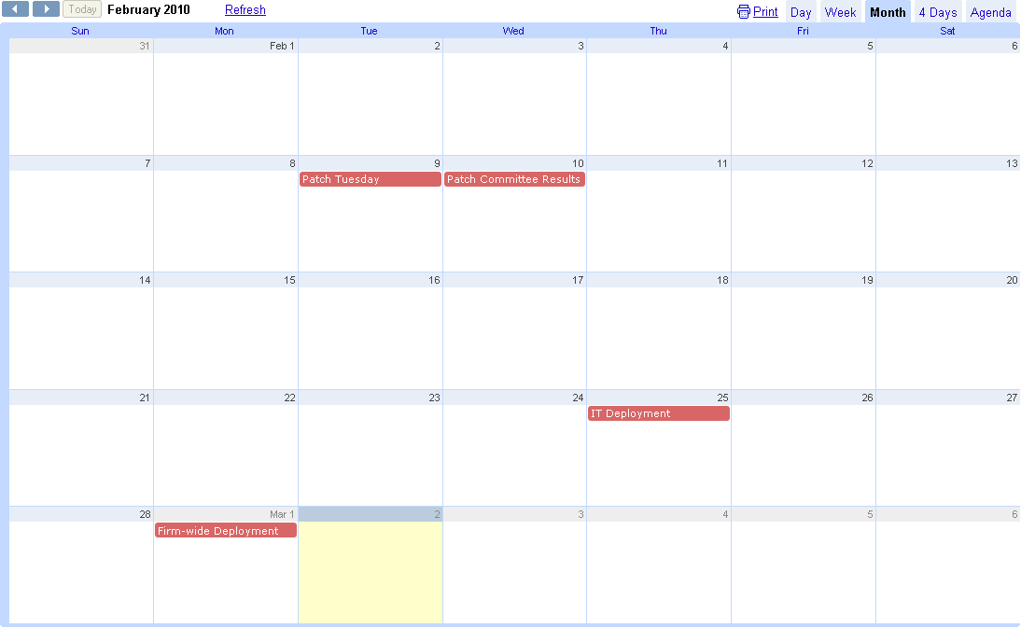
February Deployment
Patches Released
Committee Decision
Inactivity!
4PM Deployment
Deploy & Test
4PM Deployment
Notes:
- One day after patch Tuesday, patch committee releases patches to be pushed for the month
K&E currently pushes monthly OS patches out to a IT workstations starting 2 weeks after committee announcement. No testing is performed between announcement and push to IT machines. - Within one week, OS patches are pushed to the remainder of the firm.
In February 2010, IT/test patch deployment occurred at 4PM on Thursday, the 25th. If users rebooted their machines, they had 3 days to test: Friday, Saturday, and Sunday.
Users were likely in the office on Friday only
Many users likely did not reboot
How much testing was actually performed?
IF we’re not really testing anything, why did we delay the production push for 19 days?

Slide 16
Current Analysis Methods
Compliance statistics are observed but there are no established metrics against which to measure them.
No measures for successful or unsuccessful patch distributions
There are no clearly-defined remediation policies.
Notes:
-Reboots are not enforced owing to corporate culture.
- Compliance statistics are observed but are only addressed when more than 10% of machines remain vulnerable after a significant and undefined time period.

Slide 17
analysis
Why are there large numbers of vulnerable machines weeks after patches have been applied?

Slide 18
How long does it take for Altiris to notify a machine that it has work to do?
If a task is scheduled to execute at 4pm, at what time does it actually execute?
Arrival times are very fast! Are the patches actually executing?
Notes:
-Y axis shows the number of workstations that have received patches
-X Axis shows time in seconds after scheduled distribution time
-Blue bar shows number of machines that have received patches
-Red line shows aggregate % of machines that have received patches
-Red bar was the initial test group (nearly 3000 machines).
-When it comes to patch arrival and execution, exposure times are very fast.

Slide 19
Are patches actually executing?
Patches arrive quickly and have a nearly 95% rate of execution.
If 95% of machines have executed patches, why haven’t they applied?
Notes:
-Y axis shows the number of workstations that have received a particular patch
-X Axis shows Feb 2010 updates that require a reboot
-Blue bar shows number of machines that have received and executed the updates

Slide 20
What happens after patches have executed?
Will this naturally resolve as machines reboot over time?
Notes:
-Y axis shows the number of workstations that have received a particular patch
-X Axis shows Feb 2010 updates and machines that have executed the update but require a reboot for full installation
-Blue bar shows number of machines that have received the updates
-Green Bar represents the number of machines pending a reboot as of 3/2/2010

Slide 21
What happens after patches are applied?
After day 1, the number of reboots decreases dramatically.
Without intervention, it will take over a month for all machines to reach compliance.
Notes:
-Y axis shows the number of workstations that have received a particular patch
-X Axis shows bundles of information about Feb 2010 updates that require a reboot
-Blue bar shows number of machines that have received the updates
-Each bar after that represents the number of machines pending a reboot for each day that follows the patch distribution
-Red bar was the initial test group
-Green bar shows initial test group + production rollout (nearly 3000 machines).
-Since the patches were distributed, over 3300 machines have executed them (blue bar)
-After one day in production, about 40% of machines had installed the patches but had not rebooted
-These machines are still vulnerable because that haven’t rebooted!
-The good news is that 60% of users did reboot after one day
-On the second day, only about 200 machines were rebooted, leaving nearly 1250 machines vulnerable owing to lack of reboot
-This pattern (200 reboots per day) continues over the course of a week.
-Without action, this distribution is likely to have a very long tail

Slide 22
Summary and Solutions

Slide 23
Problems
Patches reach production too slowly
Eliminate two week idle period
Too many machines in ‘Reboot Pending’ status
Reducing the number of reboot pending machines will reduce exposure to malicious exploits
Metrics have not been defined
Continue effort to determine benchmark levels

Slide 24
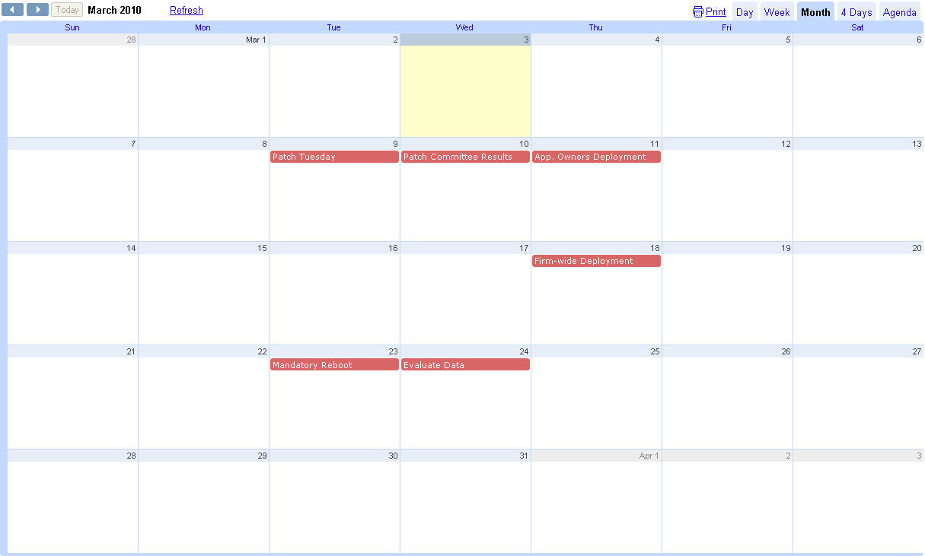
Proposed Future Deployments
Patches Released
Committee Decision
4PM Deployment
Test
4PM Deployment
Firm-wide Reboot
Remediation
Notes:
- One day after patch Tuesday, patch committee releases patches to be pushed for the month
One day after that, push patches out to deliberately chosen (and notified) application owners
Barring problems, OS patches are pushed to the remainder of the firm one week later.
Patch data is monitored for inconsistencies and failures
The next day, force a firm-wide workstation reboot.
Evaluate data against metrics 2 weeks after patch Tuesday
Begin remediation efforts after analysis is complete. Users were likely in the office on Friday only
Reduced non-reboot concerns
Ensured effective, targeted testing
Reduce patch arrival time to workstations by at least 10 days

Slide 25
Implementation Obstacles
Current culture seeks to limit technology impact on user productivity
IT changes should occur without user interruption
Effectiveness of firmwide communications not easily measurable
Are users reading communication emails?
Limited precedent for user involvement

Slide 26
Motivation

Slide 27
IT Costs
In 2002 = 300 Billion dollars
In 2010 = 500 Billion dollars
Varies by industry
Primary reason for this investment
ROI = Return on Investment
Protect Confidential Information
Reduce Liability
Notes:
The amount of money allocated to the information technology departments varies from industry to industry. However, the aggregate amount of money spent is substantial. The reason for this large expenditure is based on a number of reasons such as new computers, security measures, firewall protection, and an increase in IT staff to address updates and breaches. Another driving force behind the increase in IT expenditures is to limit liability by showing that you took adequate preventative measures.

Slide 28
Cost Per Employee
Professional Services = $8,996 (K&E)
Public Services = $2,512
Government = $12,498
Financial Services = $29,498
Telecommunications = $18,469
Retail = $1,439
Notes:
As society becomes more advanced so must the business world. The amount of money that each area of business spends on its IT department varies. This slide shows that approximately $8,996 dollars is spent per lawyer including the persons lap top, blackberry, and the security measure involved to protect the data on each. This slide is interesting because you can see how the number varies from industry to industry and how retail spend the least amount on its employees. It is also interesting to see that financial services has the highest number most likely because it deals with secure information such as bank account numbers and other confidential financial data.

Slide 29
Legal Costs/Liability
Negligence
Duty
Breach
Causation
Damages
State/Federal Court
Notes:
The number of law suits for data breaches continues to increase but the success rate for these law suits is relatively low. Data breaches include website security flaws that exposed customer data, hacking into poorly secured computer networks and databases, loss or theft of electronic records, employee theft of information and other areas as well. The primary way that litigants are establishing liability is through negligence. The law suits allege that the their was a duty by the entity to maintain the confidential information, the duty was breached when the data was exposed, and the exposure of the data caused some type of financial damages. Negligence is a state law cause of action and will vary from state to state. You can have a negligence cause of action filed in Federal court if the Federal court requirements are met but the Federal court will apply the most relevant state law. The primary areas of the data breach law suit that are problematic are the standard of care and proof of damages.

Slide 30
$$ Damages $$
Data Breach Damages
Difficult to show
Speculative
Potentially Very Large Awards
Compensatory
Out of pocket expenses
Unlikely = Pain an suffering/mental anguish
Punitive
Punish for reckless behavior in storing data
2x or 3x
Notes:
The other major problem with data breach cases is that you need to show damages. Damages in this area are very difficult to show unless the data can be linked to specific financial numbers. The fact that data has been taken with no act to linked to money is viewed by the courts as speculative and has not been treated favorably. Also the courts have not reacted well to allegations of mental anguish to people that have had their data breached. However, out of pocket expenses as a result of the data breach will be awarded and if the breaching party acted recklessly then the breaching party may have to pay punitive damages which can be double or triple the some awarded by the jury.

Slide 31
Questions?

