Slide 1
Northwestern University Network Security
Policy
Security Stacks
IPv6
Presented by Brandon Hoffman

Slide 2
Topics for Discussion What do you want to talk about?
IT Security in the Business
Policies, Standards, and Procedures
Security Stacks and Missing Data
IPv6

Slide 3
The CISO Agenda
Business
Managing 3rd Party Risk (Outsourcers)
Culture / Awareness
Executive / Board Reporting
M&A
Metrics / Benchmarking
Business Continuity
Privacy / Security Breach
Strategy
Brand Protection & Enhancement
Disaster Recovery
Alignment with Business Goals / Objectives
High Availability
CISO
Regulatory
Compliance
Technology
Enablement
Linkage to Enterprise
Risk Mgmt
Identity Management
Mobile Computing
Top-Line Growth
Evolving Threats
Compliance / Internal Audit
Manage Risk
Staffing Support
Align/Optimize Spend
Vulnerability / Patch Management
Core Functions

Slide 4
Risk
IT Security performs a critical role in assessing risk in the organization.
Vulnerability Scanning
Penetration Testing
Industry Trends
IT Strategy
Familiarity/Participation with Audit and Compliance measures

Slide 5
Audit Support
In many cases, IT Security is heavily relied upon to perform in depth testing required by an audit organization. Security is enlisted by audit because:
Technical expertise
Familiarity with current issues from internal testing
Familiarity with Policies, Standards, and Procedures

Slide 6
Compliance
Compliance may relate to internal compliance or external compliance.
Internal compliance:
Policies and Standards
Security and Configuration baselines
Framework use – ISO, COBIT, ITIL, GAISP, NIST
Best Practices

Slide 7
Compliance cont’d
External compliance:
SOX (Sarbanes Oxley)
COSO Framework
HIPAA
PCI
Safe Harbor

Slide 8
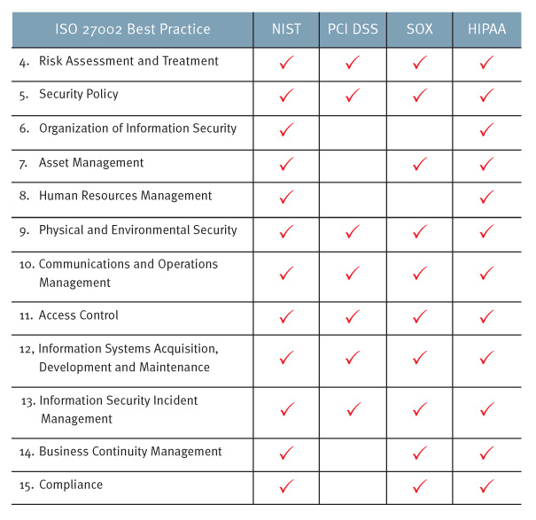
ISO Leading Practices
Source: www.rsa.com

Slide 9
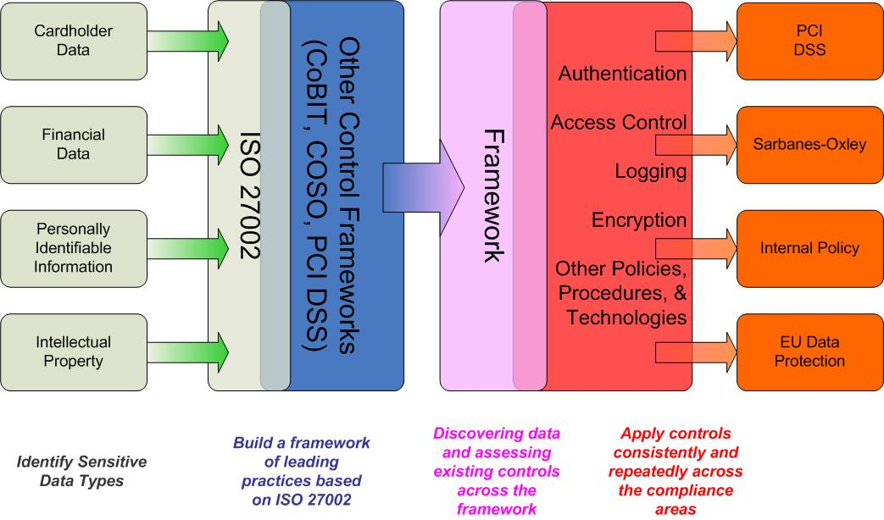
Compliance in Action
Source: www.rsa.com

Slide 10
Internal Policy
IT Security is regularly tasked with creation and enforcement of IT policies, standards, and procedures. Creation and enforcement of these documents require:
Understanding of audit roles and procedures
Familiarity with all systems, networks, and applications
Compliance considerations

Slide 11
Internal Policy cont’d
Definitions:
A Policy is a set of directional statements and requirements aiming to protect corporate values, assets and intelligence. Policies serve as the foundation for related standards, procedures and guidelines.
A Standard is a set of practices and benchmarks employed to comply with the requirements set forth in policies. A standard should always be a derivation of a policy, as it is the second step in the process of a company’s policy propagation.
A Procedure is a set of step-by-step instructions for implementing policy requirements and executing standard practices.

Slide 12
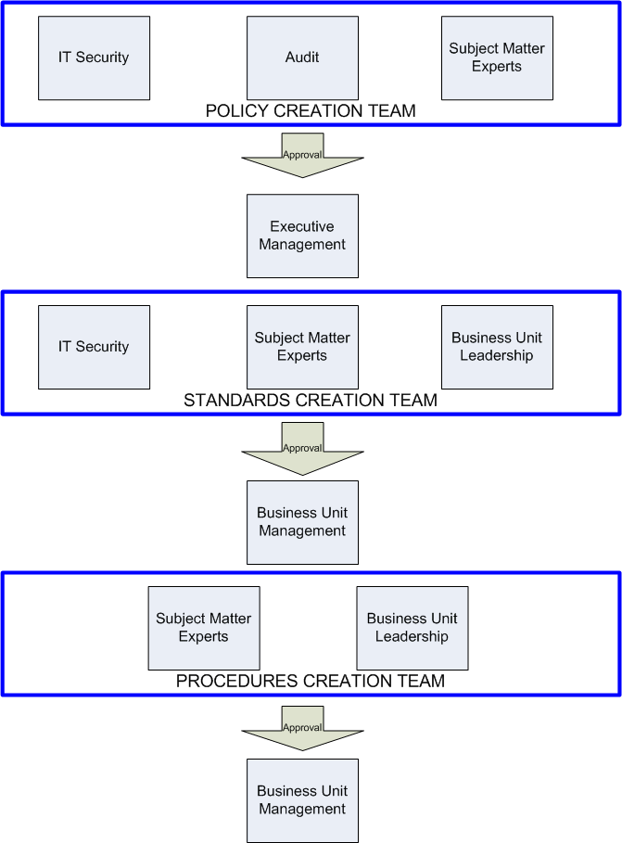
Internal Policy cont’d

Slide 13
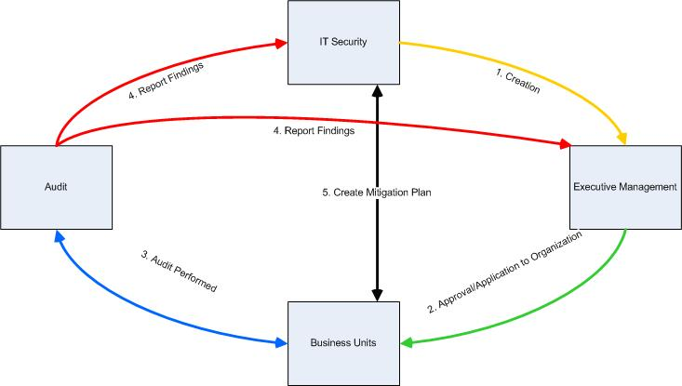
Internal Policy cont’d
Policy creation and enforcement cycle

Slide 14
Policy Business Case
A top 5 global food retailer has a massive IT/IS infrastructure and good governance….but no real policies!
Policies are the foundation for enforcing IT compliance and governance.
What policies were written for the client…

Slide 15
Policy Business Case cont’d
Policies written for IT Security:
Acceptable Use Policy
Information Classification & Ownership Policy
Risk Assessment & Mitigation Policy
Access Control Policy
Network Configuration and Communication Policy
Remote Access Policy
Business Continuity Policy
Incident Response Policy
Third Party Data Sharing Policy
System Implementation & Maintenance
Secure Application Development
Cryptography & Key Management
Mobile Computing
Physical & Environmental Security

Slide 16
Policy Business Case cont’d
Sample Policy

Slide 17
Section 2 Security Stacks Integrated Data issues

Slide 18
The Security Stack
No single device or product will provide full security. A security stack is needed.
Identity
SSO, IAM, Entitlements
Application
WAF, AppSec Analyzers, Application Testers
Data
DLP, Encryption, Session Managers, Proxies
Host/Device
Network
HBFW, HIDS, Vuln Scanners, Agents/Shims, MDM
Router ACLs, Firewalls, IPS.IDS, NAC, Modelers
Cloud
NGFWs
APT/ATA Controls

Slide 19
The Security Stack
These devices leverage data and metadata generated or analyzed by devices in other layers.
In most cases they need this data to be effective.
Identity
SSO, IAM, Entitlements
Application
WAF, AppSec Analyzers, Application Testers
Data
DLP, Encryption, Session Managers, Proxies
Host/Device
Network
HBFW, HIDS, Vuln Scanners, Agents/Shims, MDM
Router ACLs, Firewalls, IPS.IDS, NAC, Modelers
Cloud
NGFWs
APT/ATA Controls

Slide 20
The Network Layer
Example of Network Layer vendors
Network
Router ACLs, Firewalls, IPS/IDS, NAC, Modelers

Slide 21
The Host/Device Layer
Example of Host/Device Layer vendors
Host/Device
HBFW, HIDS, Vuln Scanners, Agents/Shims, MDM

Slide 22
Critical Missing Data L1-L2
Needed:
Real time index of all network devices
Validation of zone/segment access
Shadow IT identification
Edge validation
Leak paths
Unknown connected networks
Data
DLP, Encryption, Session Managers, Proxies
Host/Device
Network
HBFW, HIDS, Vuln Scanners, Agents/Shims, MDM
Router ACLs, Firewalls, IPS.IDS, NAC, Modelers

Slide 23
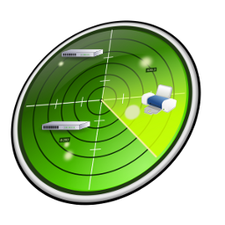
Layer 1-2 Example
Layer Zero Foundational Intelligence Tip: In order to be secure you must first know all the assets you are trying to protect.
Vulnerability Scanners identify issues on assets known to the system.
Recursive Network Indexing finds all the assets the vulnerability scanner is not aware of to ensure holistic scanning

Slide 24
The Data Layer
Example of Data Layer vendors
Data
DLP, Encryption, Session Managers, Proxies

Slide 25
The Application Layer
Example of Application Layer vendors
Application
WAF, AppSec Analyzers, Application Testers

Slide 26
Critical Missing Data L2-L4
Needed:
Real time index of all attached devices
Full device profiling
Multi-homed host identification
Unmanaged/unscanned hosts (agent/scan discrepancy)
Application
WAF, AppSec Analyzers, Application Testers
Data
DLP, Encryption, Session Managers, Proxies
Host/Device
HBFW, HIDS, Vuln Scanners, Agents/Shims, MDM

Slide 27
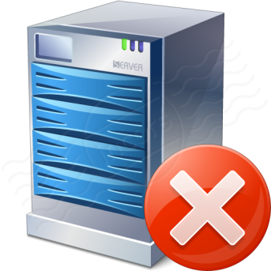
Layer 2-3 Example
Servers with agents communicate with policy server and apply data controls.
Layer Zero Foundational Intelligence Tip: To enforce endpoint control you must ensure the agent is actually on all endpoints.
Recursive Network Indexing finds all the servers/hosts with/without the agents ensuring comprehensive enforcement.

Slide 28
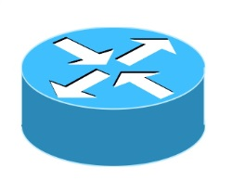
Layer 3-4 Example
Web Application traffic is passed through the Web Application Firewall (WAF)
Layer Zero Foundational Intelligence Tip: Identify all outbound paths and any hosts multi-pathing traffic.
Multi homed host or split tunneling can bypass WAF protection. Recursive Network Indexing can find these hosts.

Slide 29
The Identity Layer
Example of Identity Layer vendors
Identity
SSO, IAM, Entitlements

Slide 30
Critical Missing Data L3-L5
Needed:
Invalid/self-signed/unmanaged certificates
Traffic behind NAT/Proxies
Historic data association
Real time index of port usage
HTTP(s) banner enumeration
File share accessibility
WAF, AppSec Analyzers, Application Testers
Data
DLP, Encryption, Session Managers, Proxies
Identity
SSO, IAM, Entitlements
Application

Slide 31
Layer 3-5 Example
Applications use specific ports to communicate. Applications typically have access restricted by machine location or user.
Layer Zero Foundational Intelligence Tip: Identify all ports in use to ensure appropriate app access and find data leaks.
Recursive Network Indexing can identify all ports in use and correlate ports in use from unauthorized machines or potentially that critical data is being ex-filtrated.

Slide 32
Layer 4-5 Example
SSO and IAM Solutions depend on strong valid certificates during authentication
Layer Zero Foundational Intelligence Tip: Identify all certificates in use to ensure authentication techniques are effective.
Identity Access Management
Recursive Network Indexing finds and enumerates all certificates in use and where they are in use: Expired, Self Signed, Weak (1024 bit), Forged, Known Bad.

Slide 33
Network Situational Awareness Steps
Crawl the Network
Find Meaning in the Data
Prevent & Remediate Issues
INDEX
COMPREHEND
PREDICT
Recursively
INDEXING:
Identify all devices that comprise the network and all devices attached
Identify certificates
Identify all ports in use
Identify all banners and file shares
Profile all devices
Identify Shadow IT
COMPREHEND:
Determine unscanned hosts
Determine agentless/unmanaged hosts
Determine multi-homed hosts
Validate zone/segment access
Determine leak paths
Determine unknown/unmanaged networks
PREDICT:
Identify C2 leak paths
Correlate vulnerabilities/malware to access
Feed automated patching
Enhance asset inventory systems
Trend data for historic association and review
Close asset management gaps

Slide 34
The Security Stack: Layer Zero
Foundational intelligence to enable the security stack
Identity
SSO, IAM, Entitlements
Application
WAF, AppSec Analyzers, Application Testers
Data
DLP, Encryption, Session Managers, Proxies
Host/Device
Network
HBFW, HIDS, Vuln Scanners, Agents/Shims, MDM
Router ACLs, Firewalls, IPS.IDS, NAC, Modelers
Cloud
NGFWs
APT/ATA Controls
Layer
Zero
Network Situational Awareness via Recursive Network Indexing

Slide 35
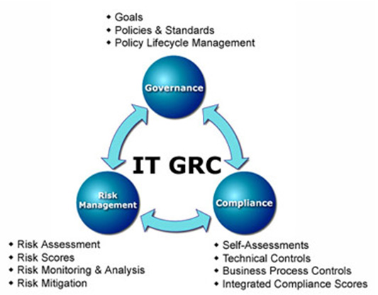
The Security Stack: Input to Governance, Risk, & Compliance
Policy expressed/enforced in technology
Identity
SSO, IAM, Entitlements
Application
WAF, AppSec Analyzers, Application Testers
Data
DLP, Encryption, Session Managers, Proxies
Host/Device
Network
HBFW, HIDS, Vuln Scanners, Agents/Shims, MDM
Router ACLs, Firewalls, IPS.IDS, NAC, Modelers
Risk factors and scores input to GRC
Cloud
NGFWs
APT/ATA Controls
Layer
Zero
Network Situational Awareness via Recursive Network Indexing
Technical controls compliment other controls and support assessments
Technical controls and other controls requirements dictate technology in stack

Slide 36
Section 3 IPv6 Design Issues for Exploit

Slide 37
ICMPv6 and Neighbor Discovery Protocol
When allowing IPv6 stateless address autoconfiguration (SLAAC), the protocol will leverage several different techniques to assign itself an IP address. This largely leverages the ICMPv6 Neighbor Discovery Protocol. Components to review:
RS/RA: Router solicitation and router advertisement. The first half of an IPv6 address is based on subnet information provided by routed infrastructure.
NS/NA: Neighbor solicitation is used to validate that the second half of the address, the interface address is not already in use by another host/device.
The key part of this is Duplicate Address Detection (DAD)
SEND: Secure Neighbor Discovery leverages cryptographic keys (with or without PKI) to assign a crypto hash in place of the second half (interface part) of the IPv6 address.

Slide 38
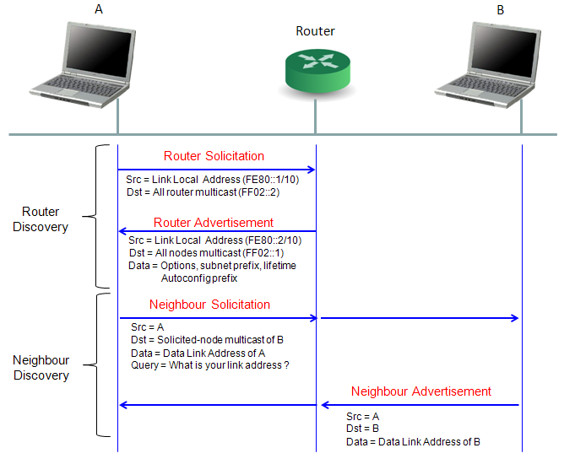
NDP Visual
Slides from www.cisco.com

Slide 39
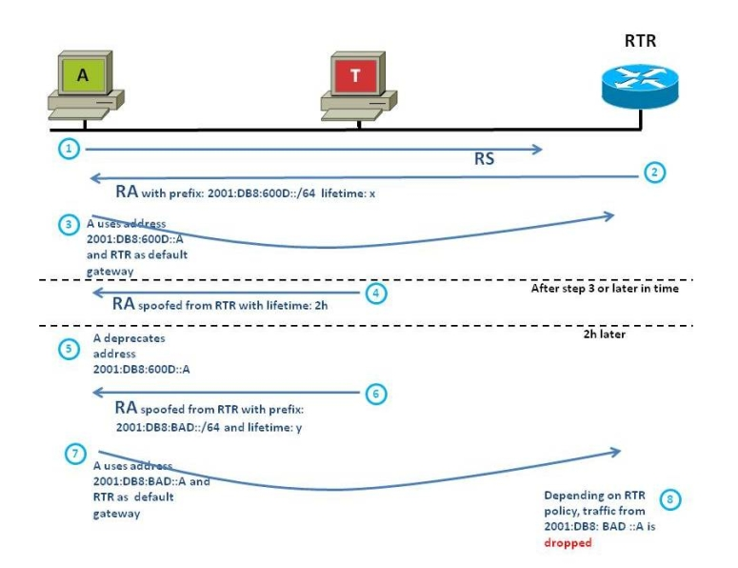
Implant Fake Router in RS/RA (also provides MiTM)
Slides from www.cisco.com

Slide 40
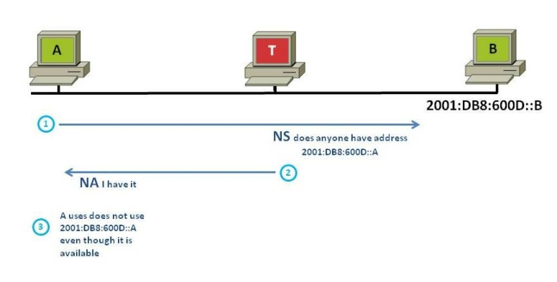
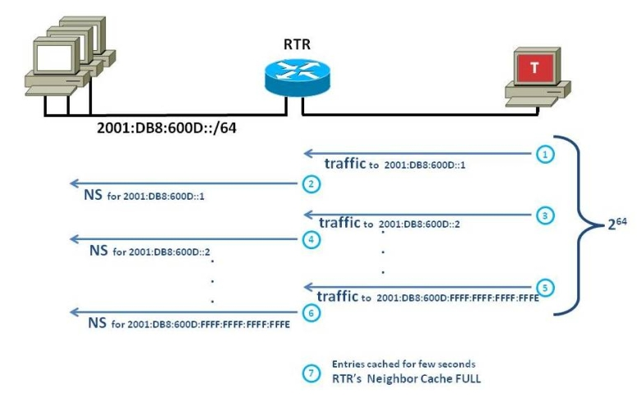
Denial of Service (DoS) in DAD
Slides from www.cisco.com

Slide 41
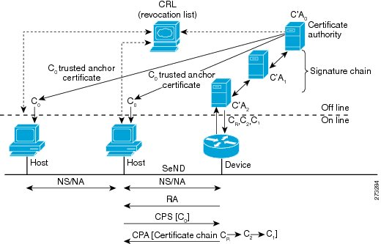
Exploit SEND with Certificates
Because PKI is not required, self-signed, forged certificates wouldn't be checked and MD5 hashing can be defeated.
Slides from www.cisco.com

Slide 42
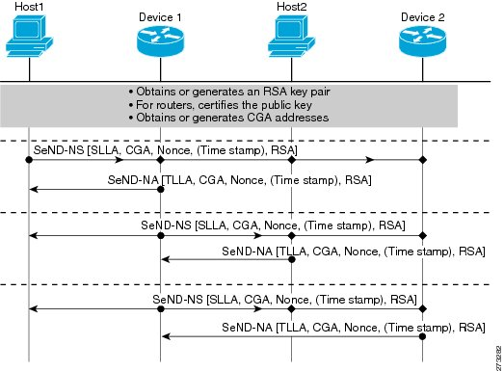
Another Certificate/CGA Example
Slides from www.cisco.com

Slide 43
Chained Attacks
Step One: Implant a router
Step Two: Leverage fake router to disrupt CGA key signing
Slides from www.cisco.com

Slide 44
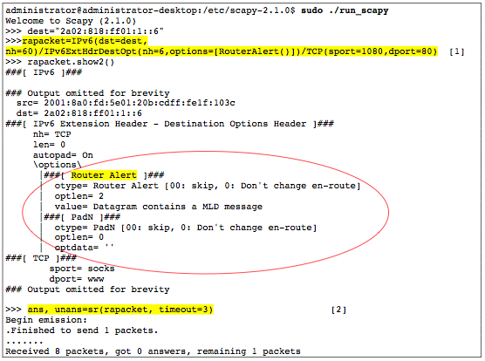
Header Extensions in IPv6
Denial of Service (DoS) using Router Alter option in Hop-by-Hop packets.
This hop-by-hop packet allows for unlimited numbers of headers to be examined by every device along path or only the destination device
There exists an option called Router Alert that requires every device along the path to look at all headers
Source: University of Lisbon
Thesis by Vitor Manuel Carujo Leitao
Title: IPv6 A New Security Challenge

Slide 45
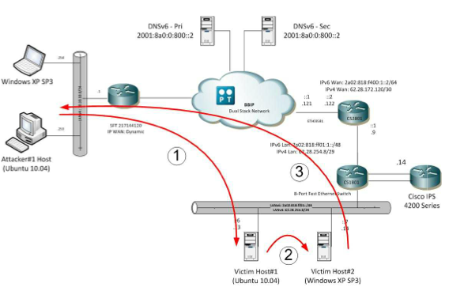
Proxy Payload Delivery (RH0)
Setting the routing header type 0 requires that each hop swaps the destination address with the next address in the routing header. This allows exploitation of a trust relationship to deliver a packet not normally able to reach the destination.
Source: University of Lisbon
Thesis by Vitor Manuel Carujo Leitao
Title: IPv6 A New Security Challenge

Slide 46
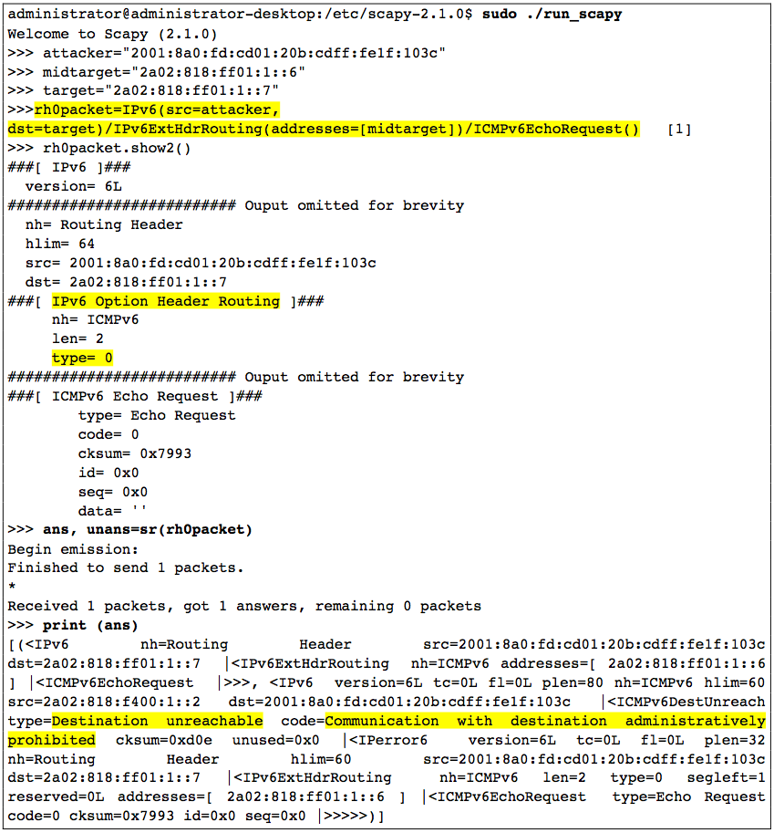
RH0 Attack Design
Source: University of Lisbon
Thesis by Vitor Manuel Carujo Leitao
Title: IPv6 A New Security Challenge

Slide 47
Avoiding These Attacks
NDP Problems (Fake Router Implantation, MiTM, and DoS)
Use DHCPv6 and do not allow SLAAC
SEND (CGA based on certs)
Use PKI and CRL servers
Header Extensions (Router Alert option)
Set and ACL to block dest-option-type 5
Header Extension (Routing Header type 0)
Do not allow IPv6 source-routing
Set ACL for routing-type 0
Notes: Many times IPv6 stacks are turned on automatically unless explicitly turned off. On hosts and network devices. Check hosts for dual-stacking and v6 protocols on routers.
Some sourced from: University of Lisbon Thesis by Vitor Manuel Carujo Leitao Title: IPv6 A New Security Challenge

